Slide 1
Module 3 Data Integration
Lesson 3: Pentaho Data Integration usage at Pinnacol Assurance

Slide 2
Pinnacol Data Integration Background
Data integration frequency daily to monthly
Especially useful for high complexity data sources
Pentaho Data Integration: primary tool
Notes:
Primary data integration tool: Pentaho Data Integration

Slide 3
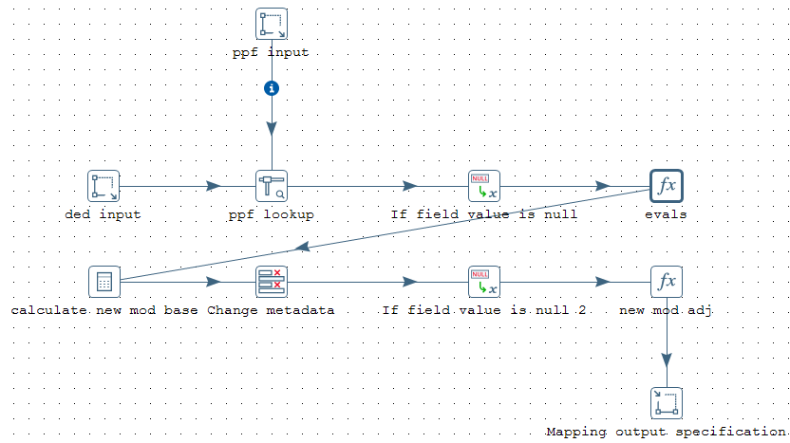
Graphical Interface Importance
Notes:
Because of the gui nature of the software, it can be quite clear what your code is doing, even if the process itself is quite sophisticated. Pentaho is also much easier to walk through with a non-technical stakeholder than a traditional ETL script—as you don’t have to explain arcane syntax.

Slide 4
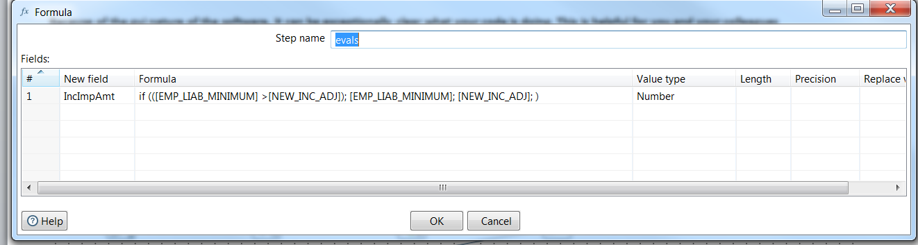
Sample Computation
Notes:
Simple conditional calculation

Slide 5
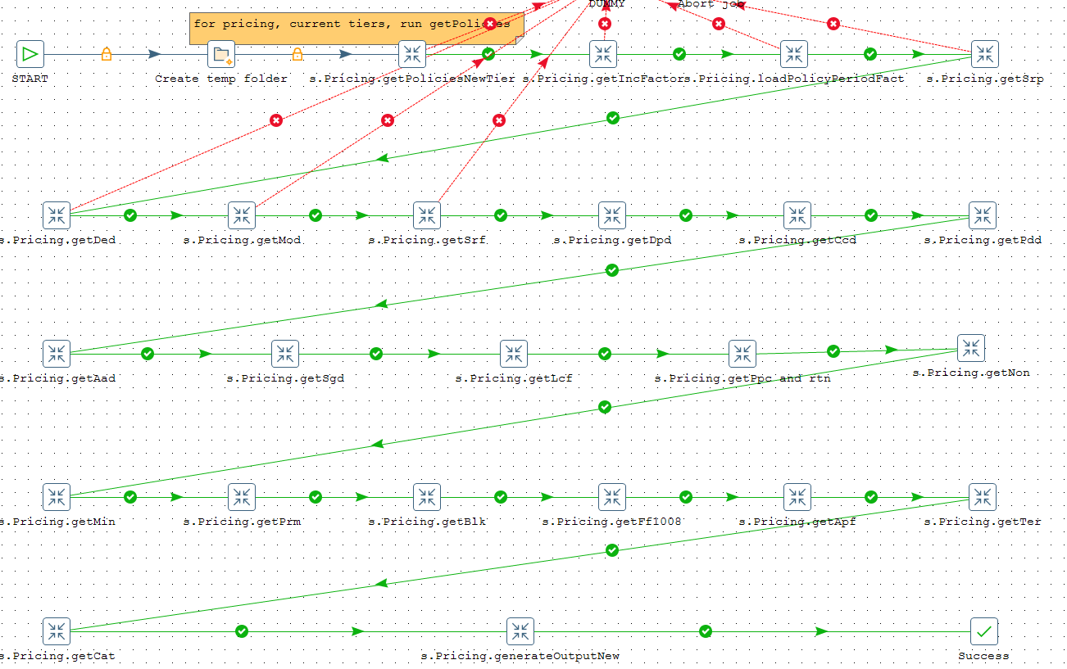
Complex Transformation
Notes:
This can code can be inserted into a transformation that uses it in a specific chain of events. This allows you to deploy and redeploy the same pieces of code quite flexibly without having to start from scratch each time you have a new use case for a specific process.

Slide 6
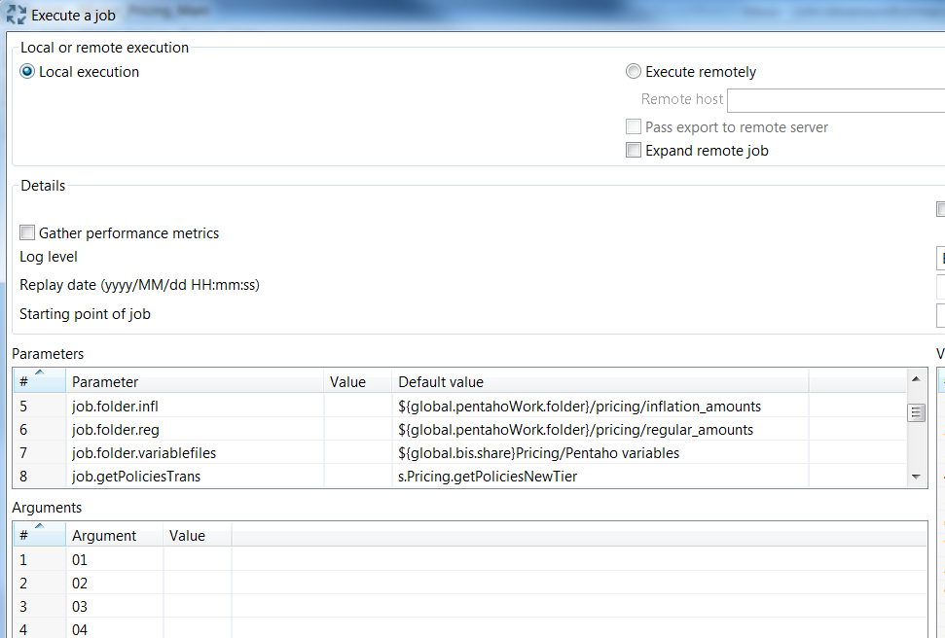
Parameter Specification
Notes:
Parameterization can be built into the code so that you can iterate quickly with different inputs as your task changes. These parameters can themselves be composed of global kettle variables that are reused on a frequent basis (e.g., connection info for databases; authentication credentials, log tables, etc.). This parameterization makes remote execution of these sorts of scripts quite feasible.

Slide 7
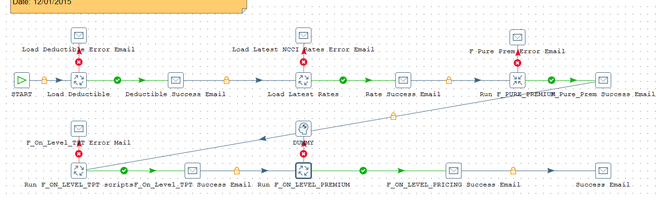
Job Development
Notes:
Finally, these transformations can be themselves parameterized and integrated into full-fledged jobs, with rigorous unit testing of the code and robust error handling steps to allow you as the developer have clear line of sight into your job’s progress and performance.

Slide 8
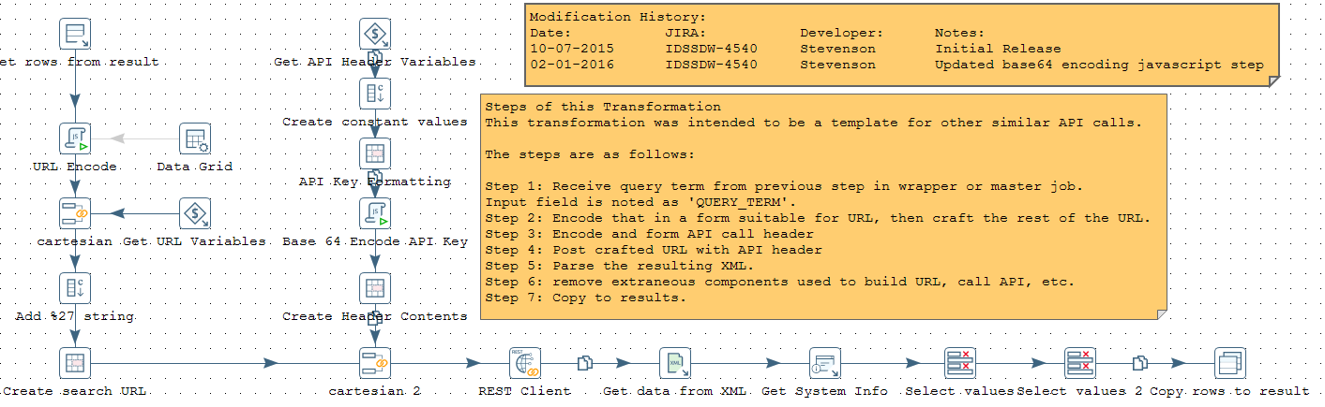
Transparent Documentation
Notes:
The interface also allows for really transparent documentation of your process—in the script itself—rather than in some separate file or as comments buried in the code itself.

